Slide 1
Traversal Shaders on Current GPUs
By Markus Robert Hall
Notes:
Welcome

Slide 2
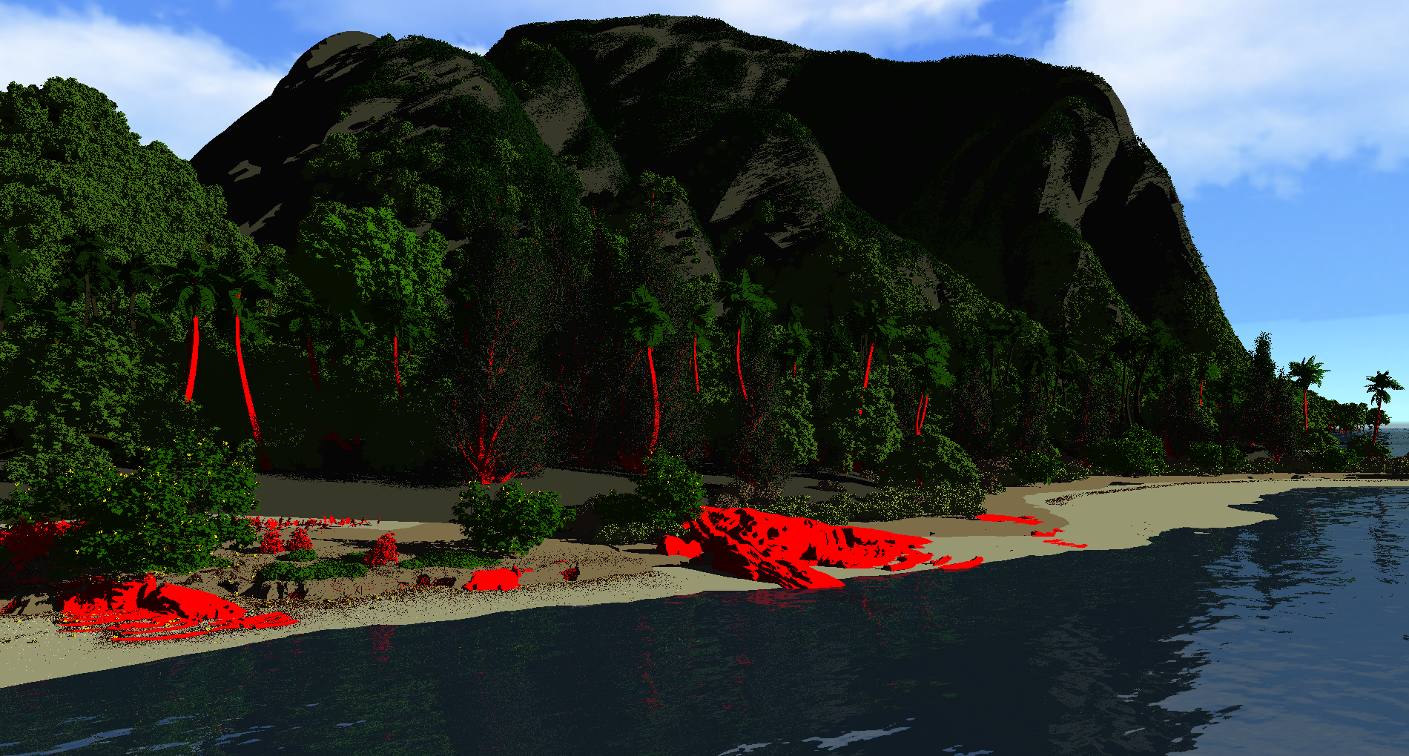
Rendering Moana Island
Moana Island Disney Production asset
>5M instances
>22B triangles
<6GB VRAM for AS
>30FPS
Raytracing only!

Slide 3
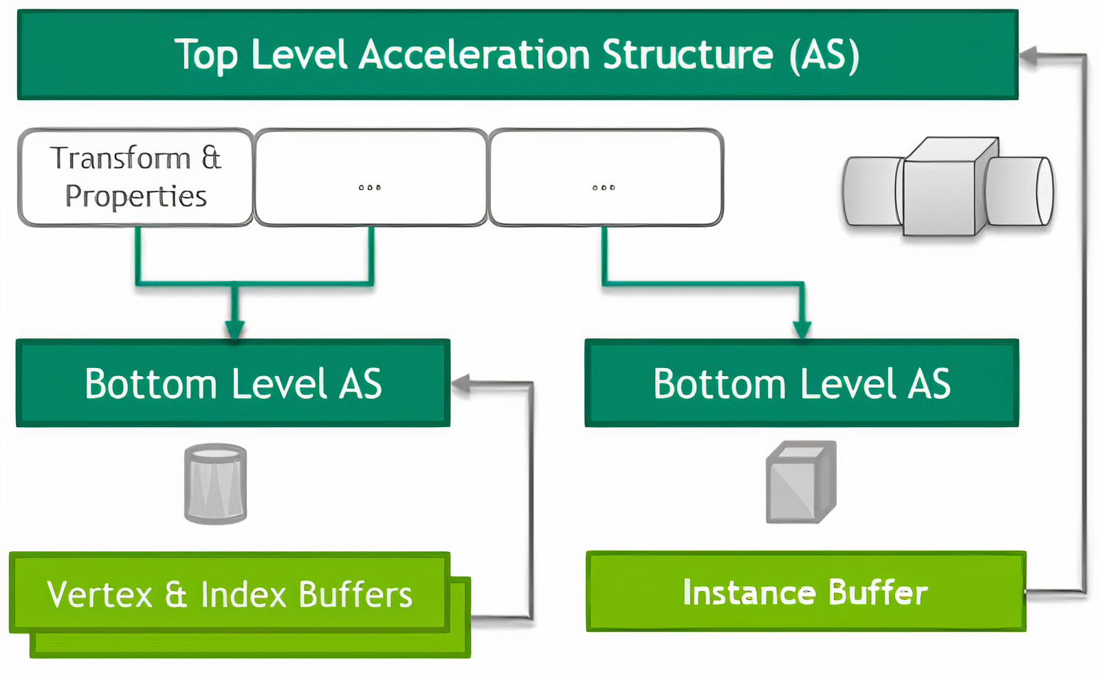
Raytracing currently – Acceleration structures

Slide 4
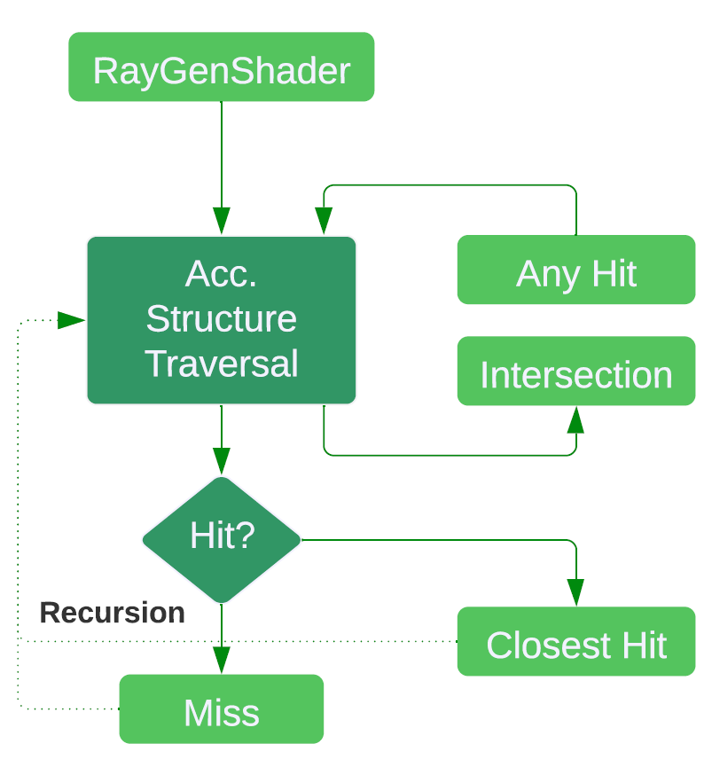
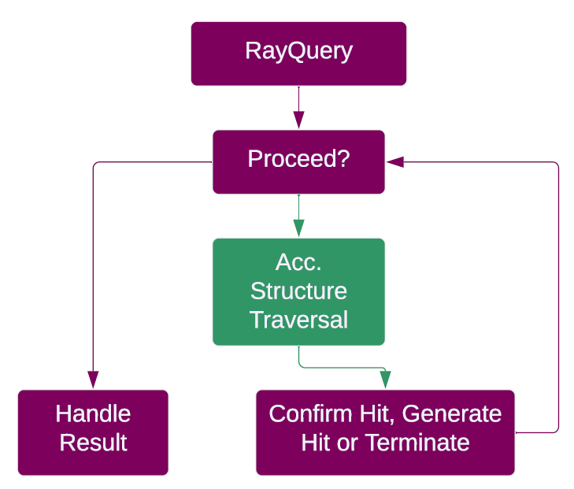
Raytracing currently

Slide 5
Current Raytracing limitations
Two levels (TLAS & BLAS)
Traversal path is unmodifiable while running
Level-of-Detail must be set before each render
Acceleration structures consume a lot of memory
Overhead between RT-Core and Shader

Slide 6
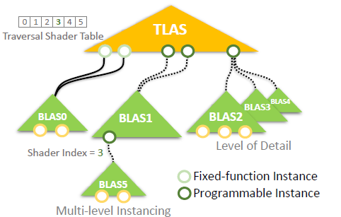
Traversal Shader – Model
By TODO CITE
Proposes programmable instances (PIs)
PIs = AABB with attached traversal shader
Traversal shader can modify AS traversal
PIs in TLAS and BLAs allowed

Slide 7
Traversal Shader – Programming
Traversal over multiple BLAS
State description requires stack
Traversal shader layout example:
Check PI flags
Calculate workloads
Determine next AS
Push AS onto the stack
Image mit state und stack of traversal, visualize need of stack and payloads

Slide 8
Traversal Shader – Implementation
PIs as AABBs
PI only in BLAS
Retrieve PI struct from buffer
Struct contains custom data
Determine node to traverse next
Save to the stack
Run until stack is empty

Slide 9
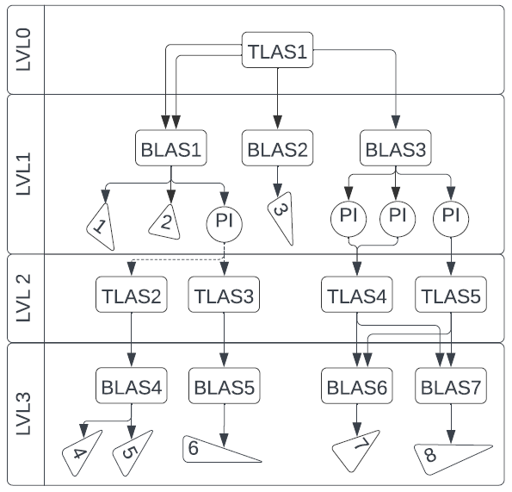
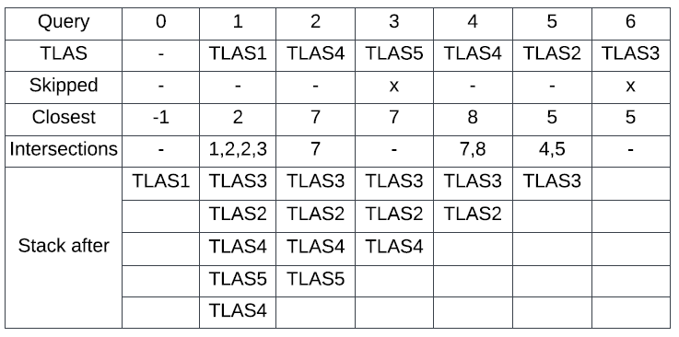
Traversal Shader – Example

Slide 10
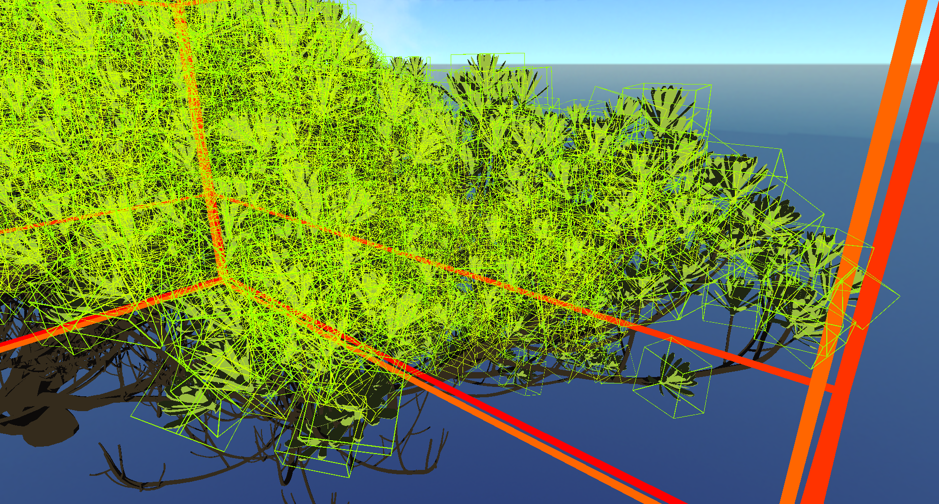
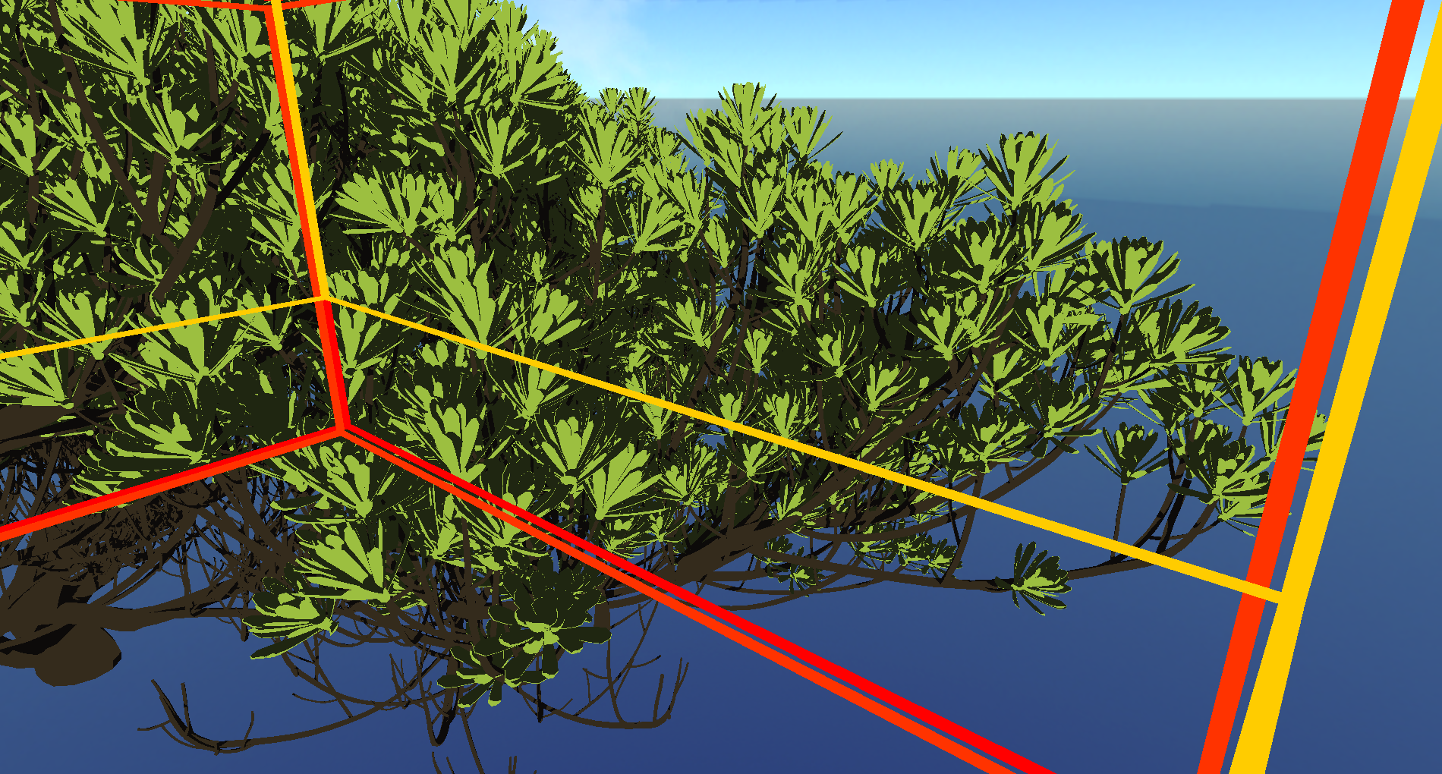
Bottlenecks – Instance overlap
Too Many PIs
Pis Merged

Slide 11
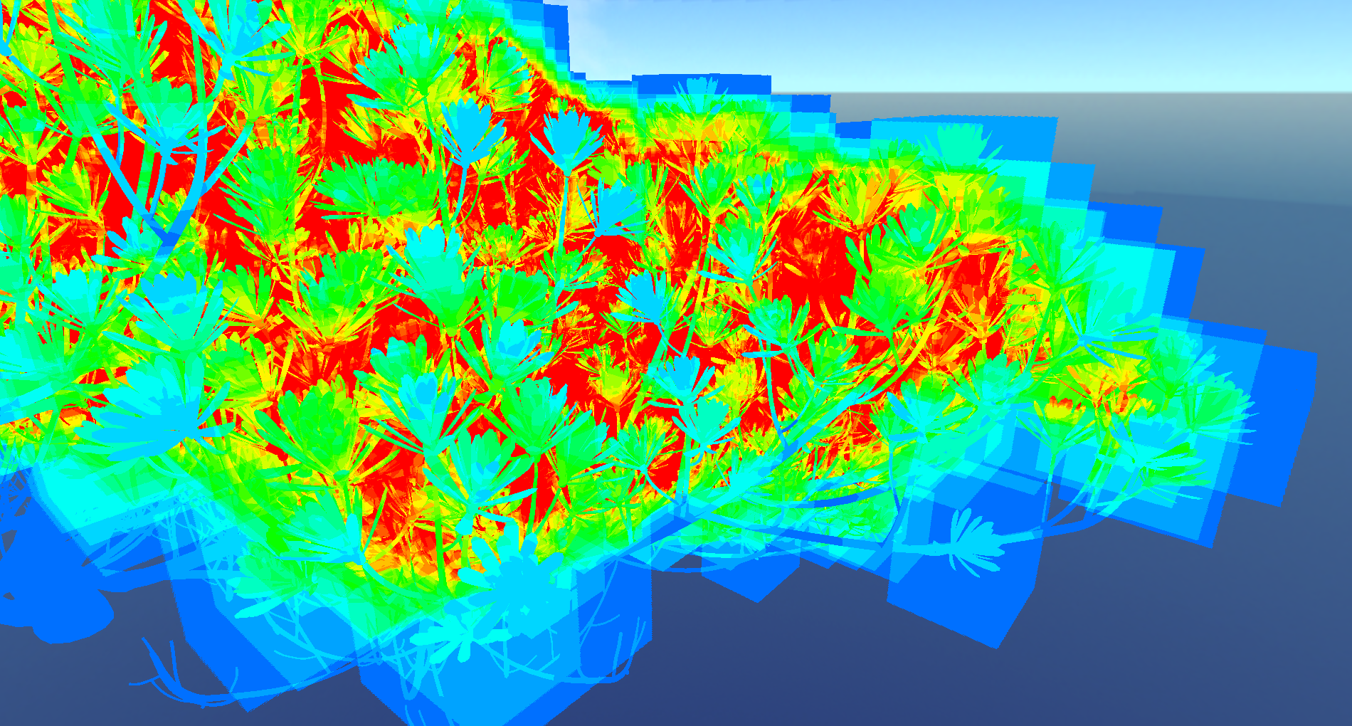

Bottlenecks – Instance overlap
24 FPS
220 FPS

Slide 12
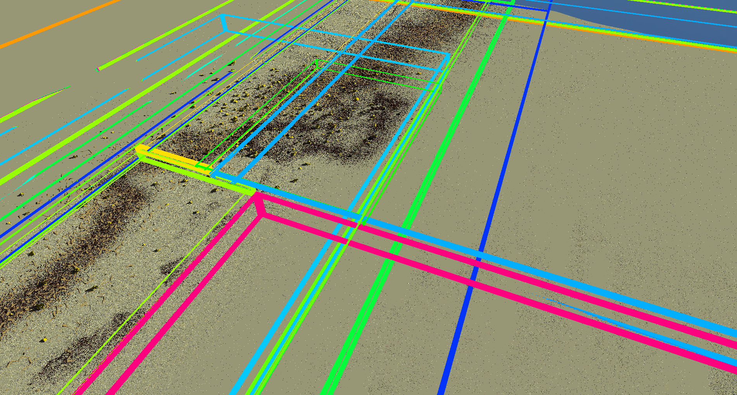
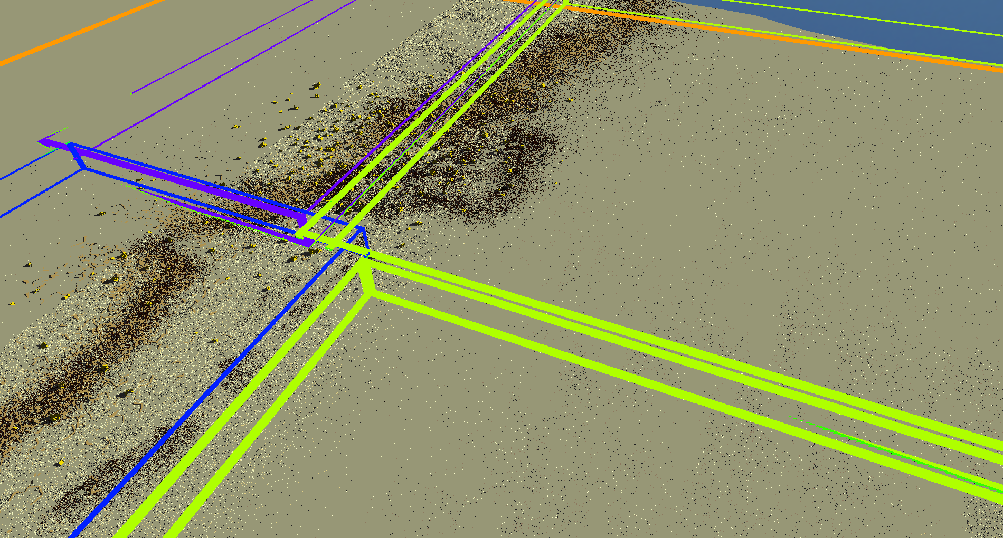
Bottlenecks – AABB Overlap
Unprocessed-38FPS
Processed-128FPS

Slide 13
Bottlenecks - More
Register Usage
Minimize payload size
Ray Query speed
Only copy PI data
Add payload later
Device limits
Traversal shaders can bypass some

Slide 14
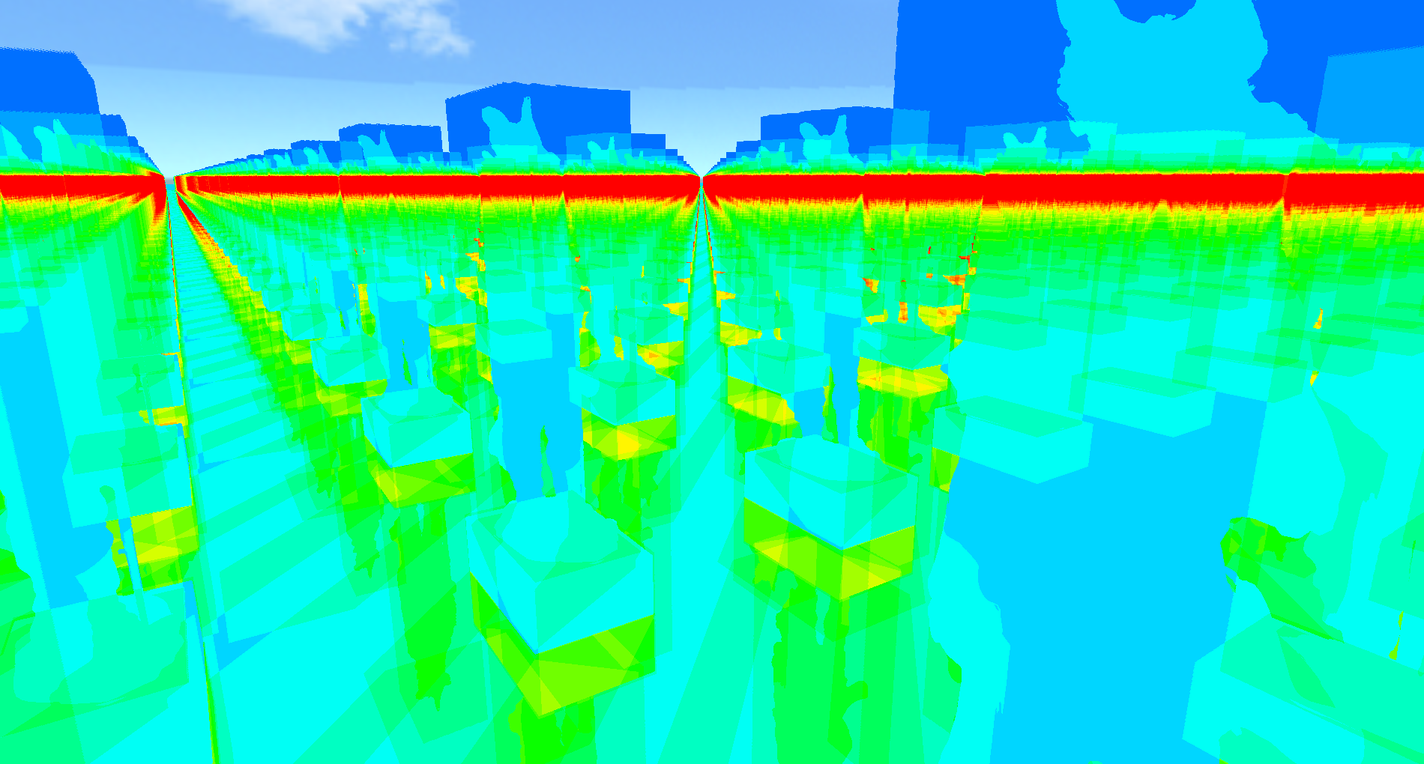
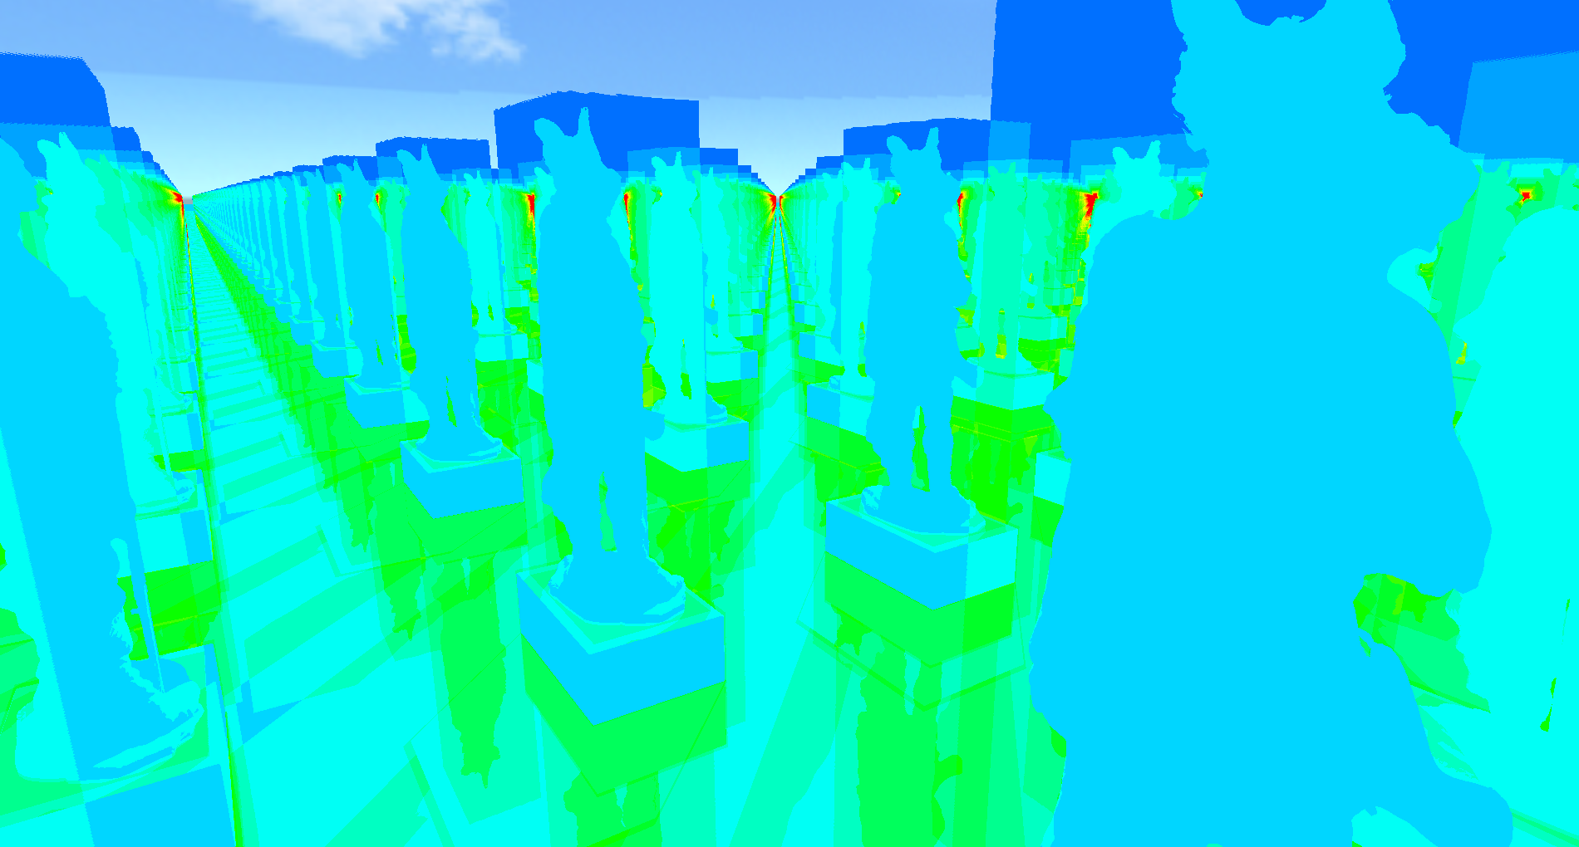
Performance – Order matters
52FPS
60FPs

Slide 15
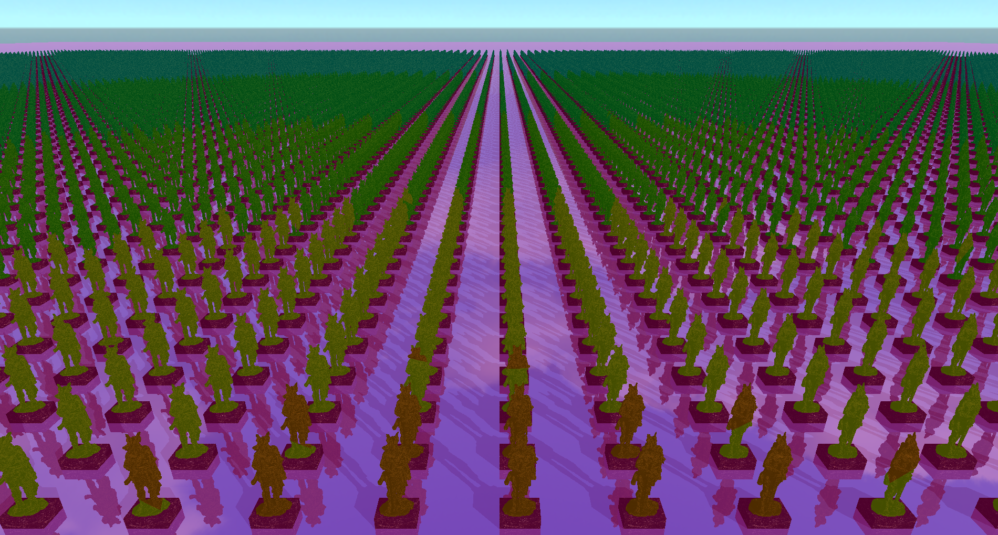
Results – LOD
Dynamic LOD works
Improves cache hit rates
Improves framerate a bit
Can be used in some cases
Too much leads to shader overhead

Slide 16
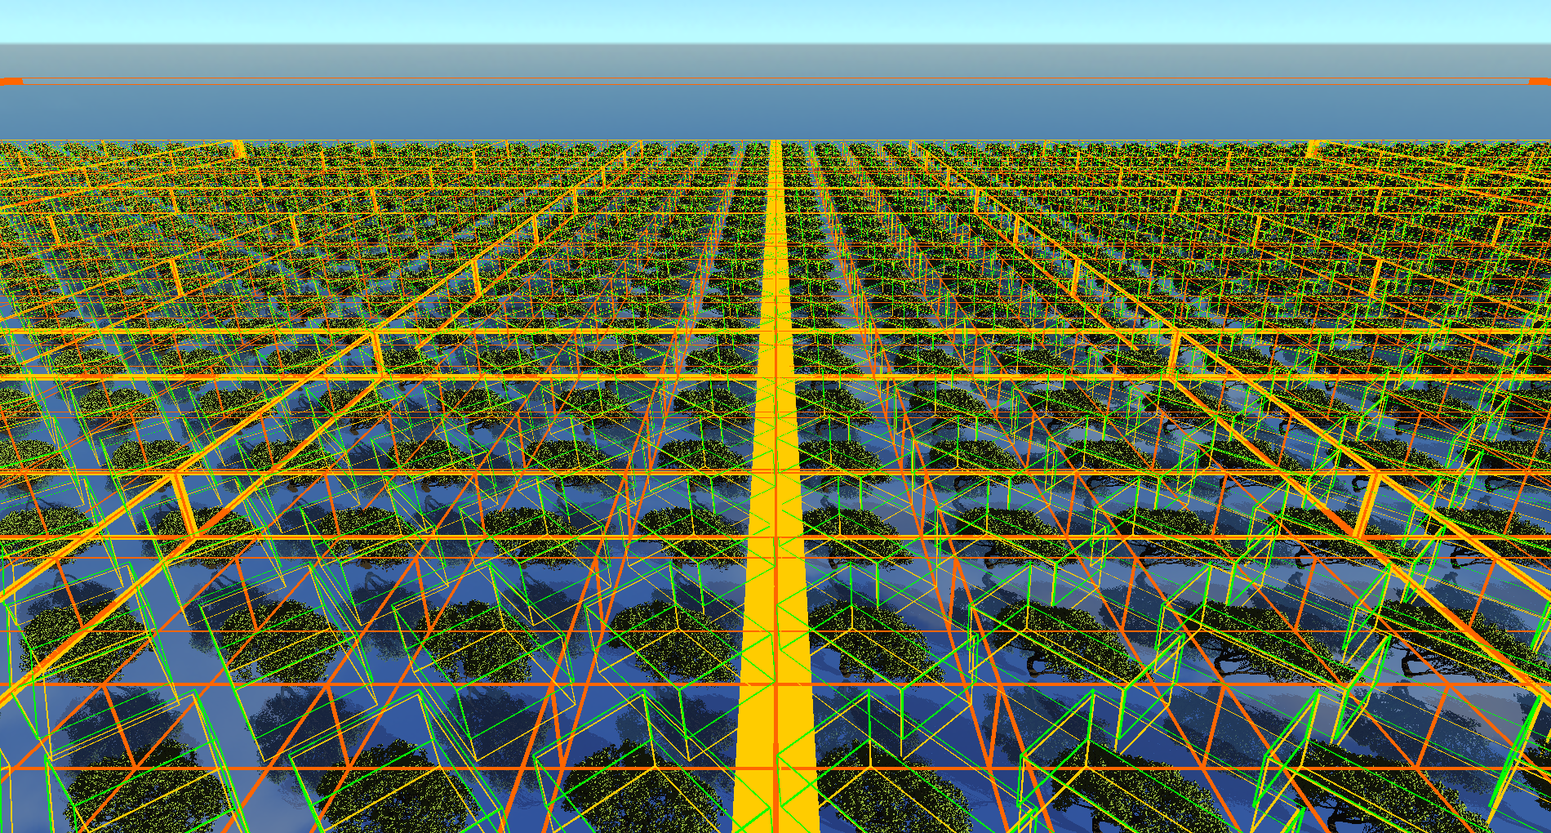
Results – Multi-Level-Instancing
Multi-Level-Instancing works
Can save large amounts of memory
Our example 94% memory
Artifacts if stack size to low
Can decrease performance if used too much
Up to 50% FPS loss

Slide 17
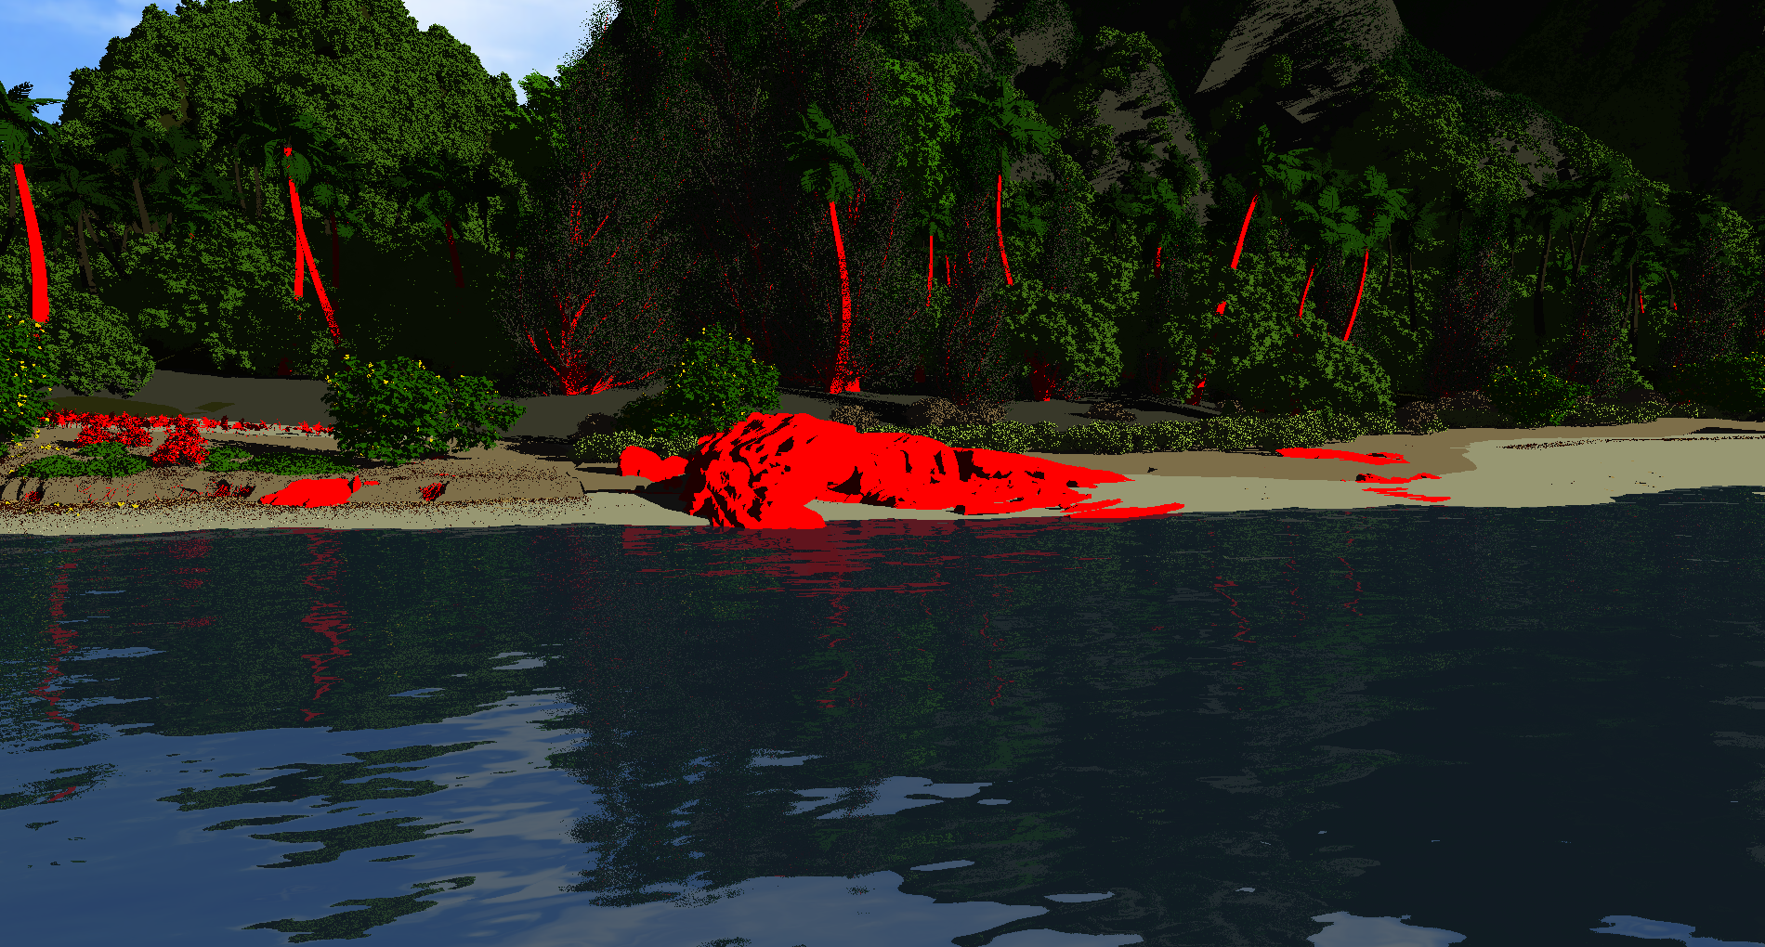
Results – Moana Island
Real time FPS (>30)
ML can save GBs of VRAM
Almost no performance impact to SL
Real-world application!
Scene optimization matters a lot!
Moana Island still has room for improvement

Slide 18
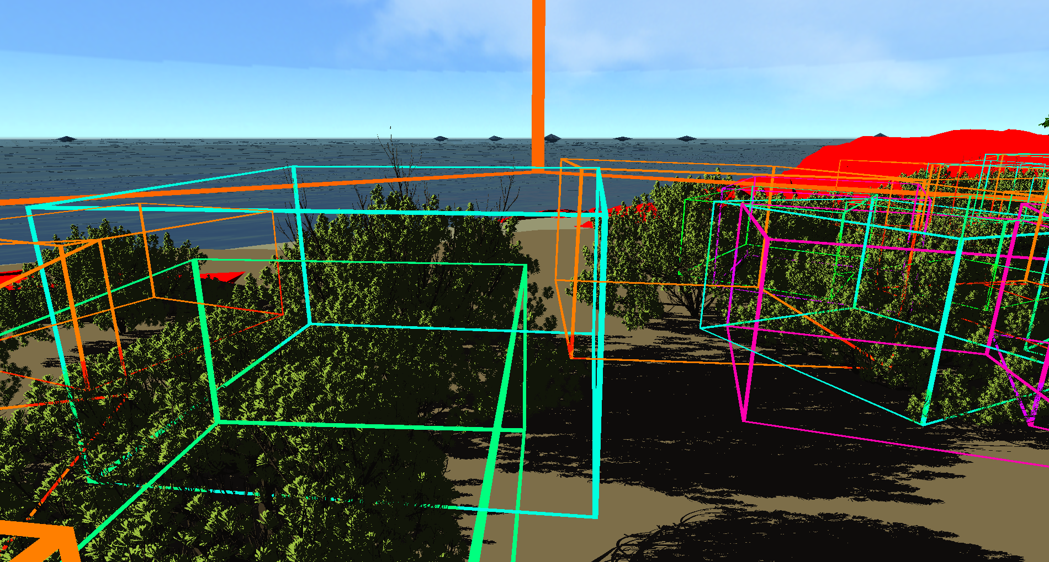
Conclusion
Moderation is key
Traversal shader can be used in some cases
Attention to performance traps
Overuse
Overlap
To many recursions
Too many levels
Unnecessary LOD

Slide 19
Usage
Level-of-Detail
Multi-level-instancing
Portals
Reduced rebuilds
Lazy build
Other light-path manipulations

